Slide 1
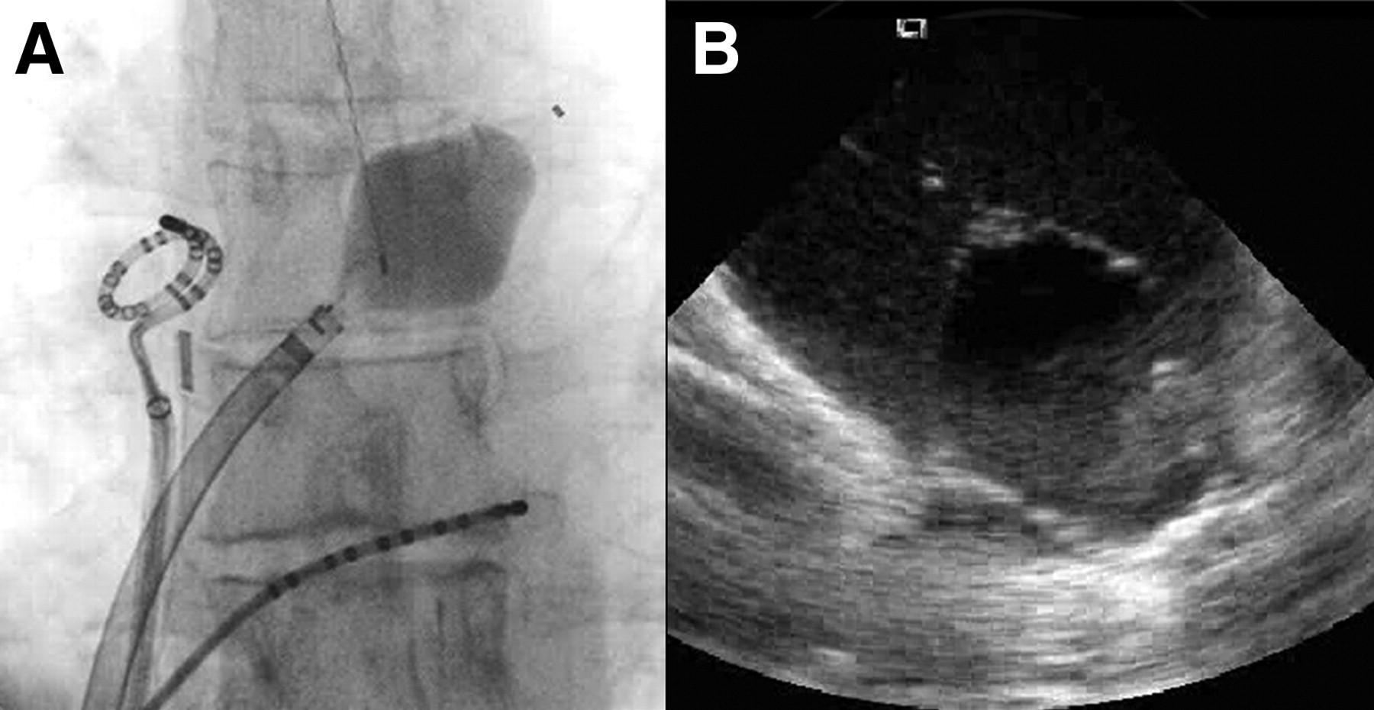

Figure 3. Positioning the balloon ablation catheter.
Reddy V Y et al. Circulation 2009;120:12-20
Copyright © American Heart Association
Notes:
Figure 3. Positioning the balloon ablation catheter. Shown are fluoroscopic (A) and intracardiac ultrasound (B) images of the balloon catheter positioned at the ostium of the left superior PV in a clinical case. Note that the esophageal temperature probe was positioned so that it was at the same vertical level as the balloon.

